Slide 1
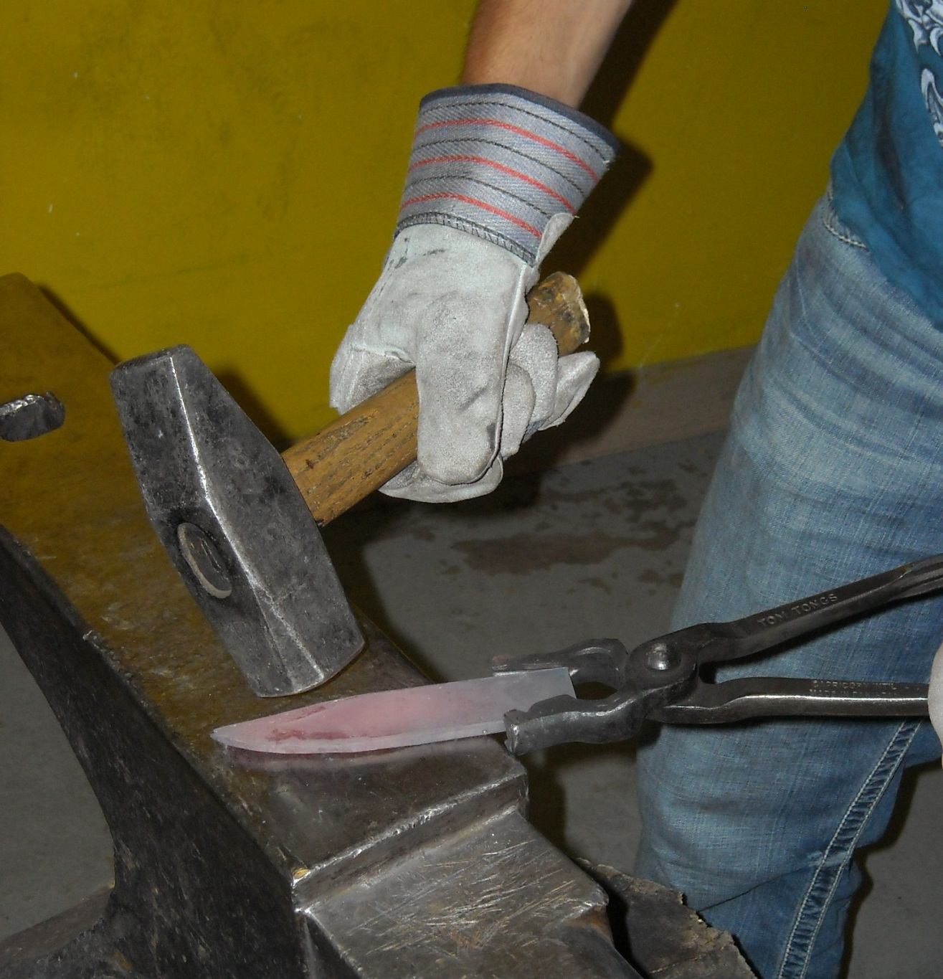
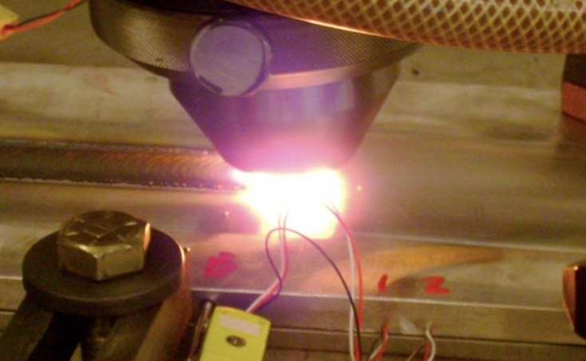
Friction Stir Processing (FSP) Knife Making: Old vs. New
Derrick Schell, Dr. Michael West
South Dakota School of Mines and Technology
Metallurgical Engineering Department
Research Made
Possible by NSF REU Grant #0852057
Abstract
Objectives
This poster describes the process used in our investigation of Friction Stir Processing (FSP) in blade making using D2 Tool Steel. A FSP knife will be tested against a knife made using traditional methods, for microstructure as well as hardness.
Results
To create a knife using traditional methods.
To create a knife using friction stir welding methods.
Compare the two knives for physical and metallurgical properties
Preliminary Results Figure 1
Vickers hardness testing was done on the as-received D2, and the average was 208.8 HV
Traditional Knife Figure 2
Vickers hardness testing was done on the traditional D2 blade, both the as quenched and tempered.
Air Cooled average: 567.9 HV
Tempered average: 544.4 HV
FSP Knife Figure 3
Vickers Hardness Testing was done on the FSP D2 test welds, and weld 2, 200 RPM, 6000 lbs. downward force, 2 in/min, had an average hardness in the nugget of: 712.7 HV
Procedures
Preliminary Work
The as-received D2 Tool Steel was cut, ground, polished and etched so that it could be looked at under a microscope.
Traditional Knife – Figure 4
To create the traditional knife, a piece of quarter inch thick D2 plate was cut into an inch by five inch piece and heated in a propane forge.
After the piece had been shaped, it needed to be heat treated,
Hardened- 260 degrees Celsius 20 min
- 650 degrees 20 min
- 995 degrees 5 min
Tempered – 1 hour @ 232 degrees Celsius
Friction Stir Processed Knife – Figure 5
Test welds were made on the quarter inch thick plate. The parameters were as follows:
400 RPM to plunge, 200 RPM afterwards
6000 Ibs downward force
The travel speeds varied from 2, 3, and 4 inchers per minute.
Figure 1: As-received D2 at 500X
Figure 2: Traditional Knife
Figure 3: FSP Knife
Conclusions
FSP helps improve the physical properties of a D2 Tool Steel Blade.
With a Vickers Hardness of 600 -800 HV, compared to 550HV, it is promising for a sharper edge that lasts longer.
Further investigation into FSP of D2 Tool Steel blades needs to be continued.
Figure 4: Forging Traditional Knife
Figure 5: High Temperature Friction Stir Weld
Graph 1: Hardness Testing
Future Work
Compare grain size of parent, traditional, and friction stir processed samples.
Try different combinations of heat treatments of the traditional knife.
Try different travel speeds and force on FSP knife as well as heat treatment of FSP knife.
.
Acknowledgments
Thanks to the National Science Foundation grant # 0852057, Dr. Michael West, Dr. Bharat Jasthi and Dr. Alfred Boysen

